Slide 1
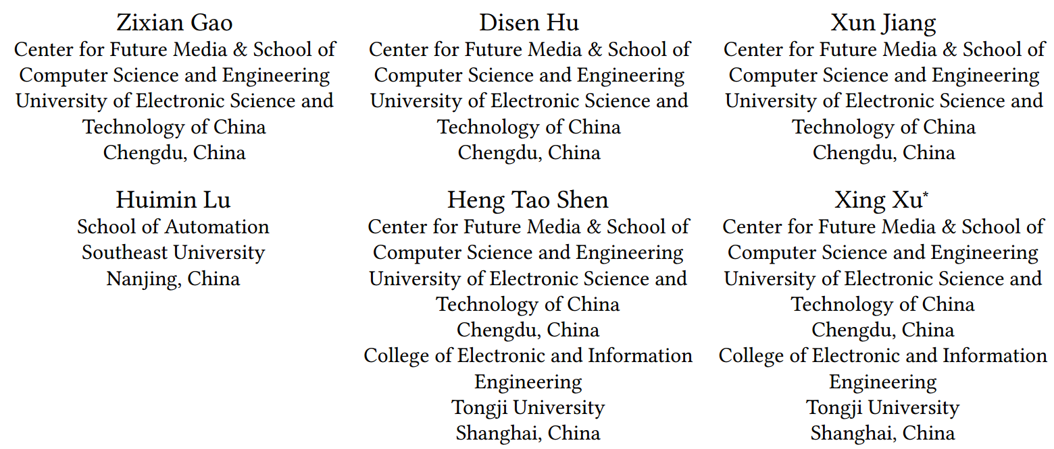
ATAI
Advanced Technique of Artificial Intelligence
ATAI
ChongqingUniversity _{AdvancedTechniqueof}
of Technology Artificial Intelligence
Chongqing University of Technology
Chongqing University ^{ATAI}
_{of Technology} Advanced Techniqueof
Artificial Intelligence
Chongqing University of Technology
Chongqing University of Technology
EUAR:Enhanced Experts with Uncertainty-Aware Routing for
Multimodal Sentiment Analysis
Code: https://github.com/ZixianGao/EUAR
2024.12.5•ChongQing
——ACM MM 2024
Reported by Lele Ren
1

Slide 2
ATAI
AdvancedTechniqueof
Artificial Intelligence
ATAI
ChongqingUniversity _{AdvancedTechniqueof}
of Technology Artificial Intelligence
ChongqingUniversity of Technology
Motivation
Traditional methods rely heavily on information interaction between modalities and lack effective handling of noise within individual modalities. At the same time, the widespread presence of uncertainty in multimodal data can weaken the model's decision-making ability.
This paper proposes quantifying uncertainty and dynamically selecting the most suitable expert mechanism to handle data with different levels of noise.

Slide 3
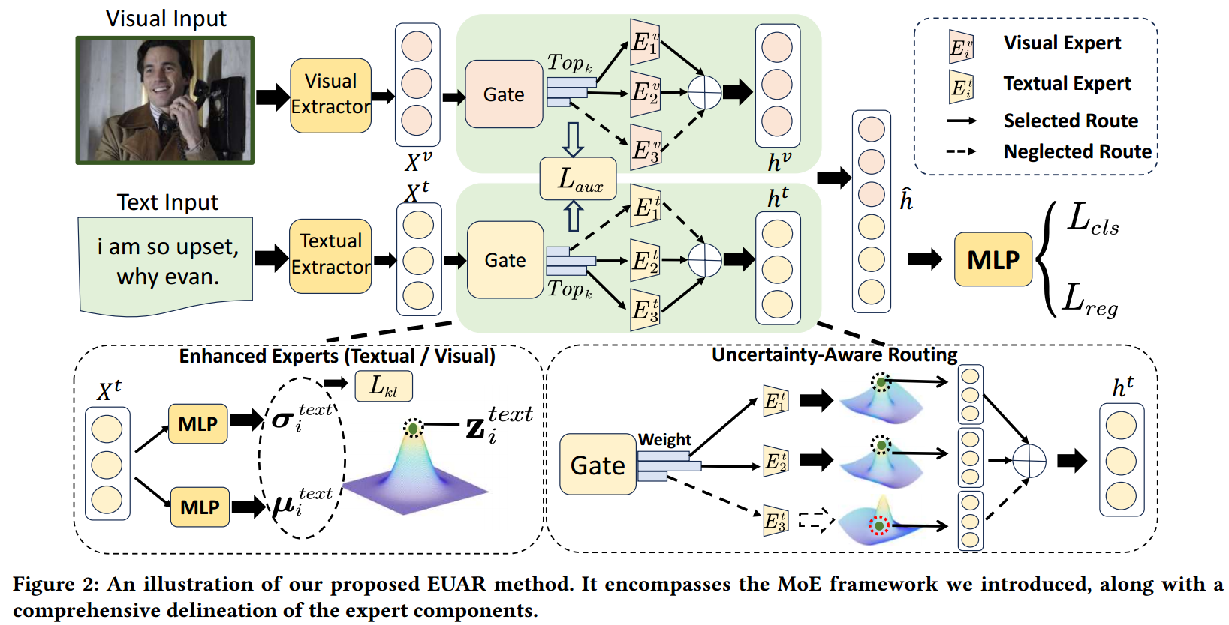
ChongqingUniversity of Technology
ATAI
AdvancedTechniqueof
Artificial Intelligence
ATAI
ChongqingUniversity _{AdvancedTechniqueof}
of Technology Artificial Intelligence
Overview

Slide 4
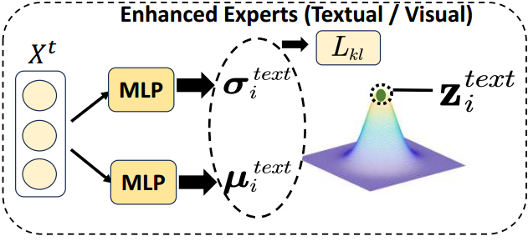
ChongqingUniversity of Technology
ATAI
AdvancedTechniqueof
Artificial Intelligence
ATAI
ChongqingUniversity _{AdvancedTechniqueof}
of Technology Artificial Intelligence
Method

Slide 5
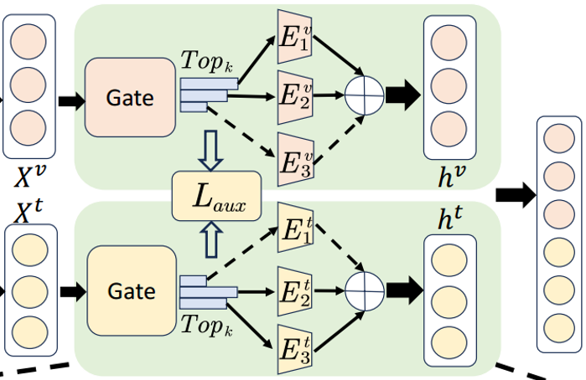
ChongqingUniversity of Technology
ATAI
AdvancedTechniqueof
Artificial Intelligence
ATAI
ChongqingUniversity _{AdvancedTechniqueof}
of Technology Artificial Intelligence
Method

Slide 6
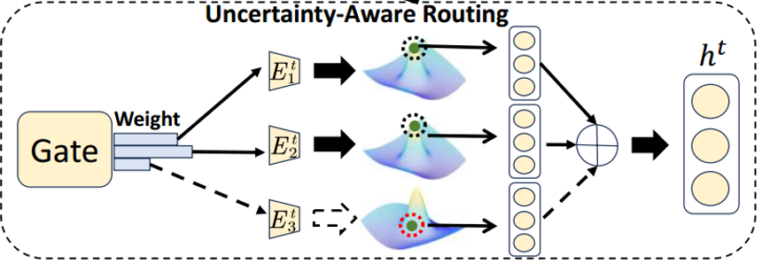
ChongqingUniversity of Technology
ATAI
AdvancedTechniqueof
Artificial Intelligence
ATAI
ChongqingUniversity _{AdvancedTechniqueof}
of Technology Artificial Intelligence
Method

Slide 7
ATAI
AdvancedTechniqueof
Artificial Intelligence
ATAI
ChongqingUniversity _{AdvancedTechniqueof}
of Technology Artificial Intelligence
ChongqingUniversity of Technology
Experiments

Slide 8
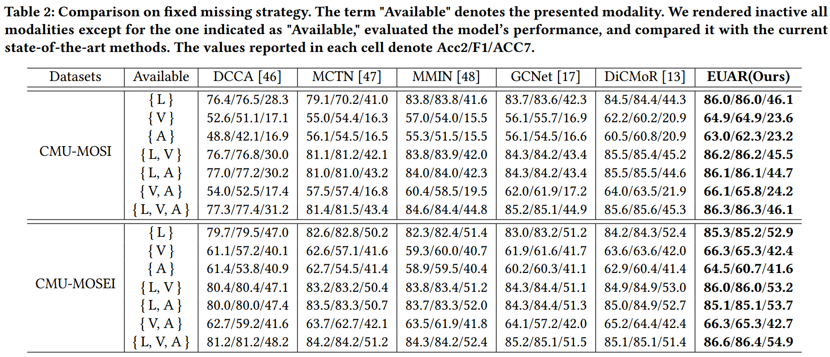
ATAI
AdvancedTechniqueof
Artificial Intelligence
ATAI
ChongqingUniversity _{AdvancedTechniqueof}
of Technology Artificial Intelligence
ChongqingUniversity of Technology
Experiments

Slide 9
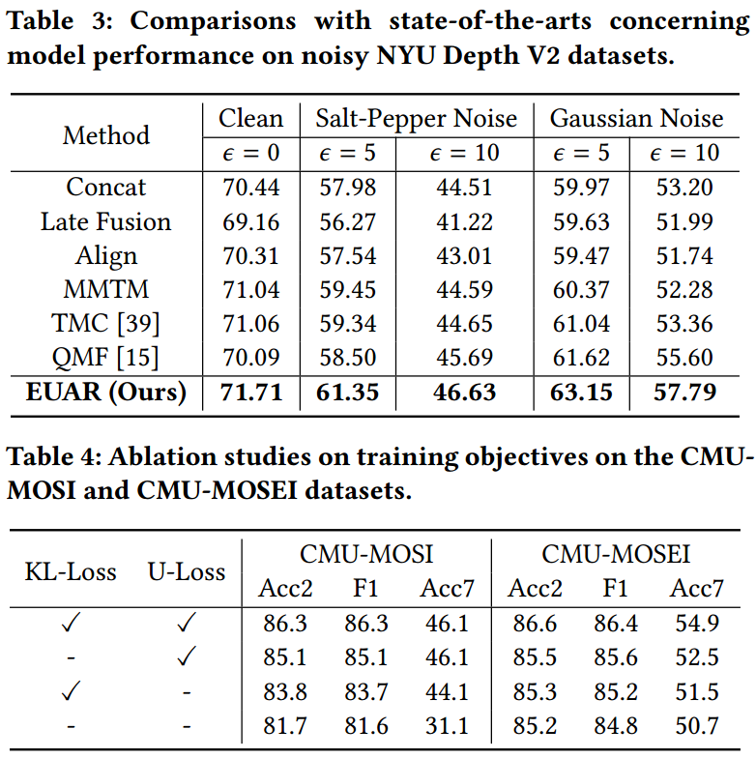
ATAI
AdvancedTechniqueof
Artificial Intelligence
ATAI
ChongqingUniversity _{AdvancedTechniqueof}
of Technology Artificial Intelligence
ChongqingUniversity of Technology
Experiments

Slide 10
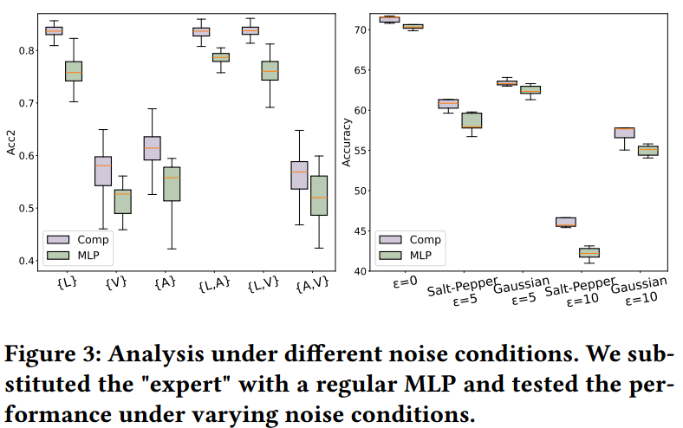
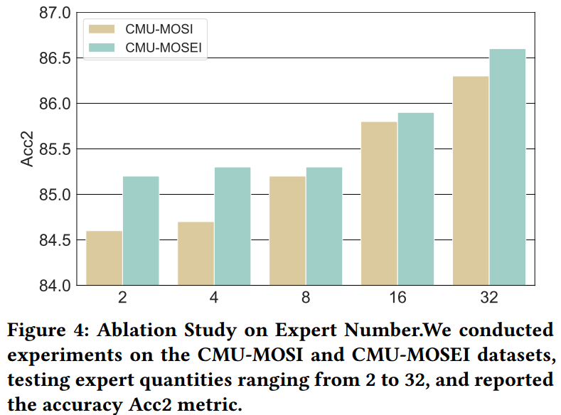
ATAI
AdvancedTechniqueof
Artificial Intelligence
ATAI
ChongqingUniversity _{AdvancedTechniqueof}
of Technology Artificial Intelligence
ChongqingUniversity of Technology
Experiments

Slide 11
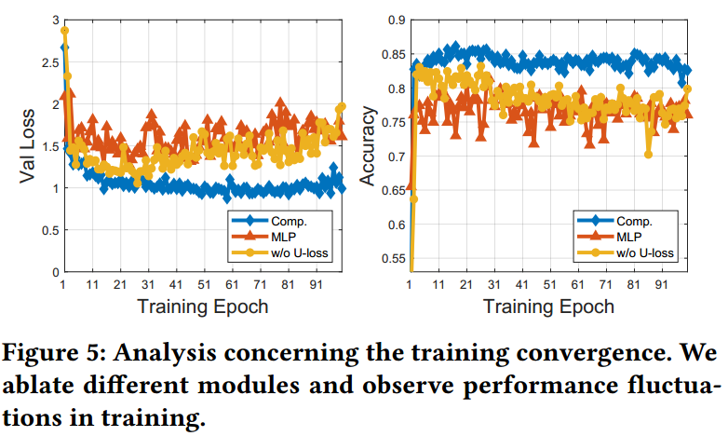
ATAI
AdvancedTechniqueof
Artificial Intelligence
ATAI
ChongqingUniversity _{AdvancedTechniqueof}
of Technology Artificial Intelligence
ChongqingUniversity of Technology
Experiments

Slide 12
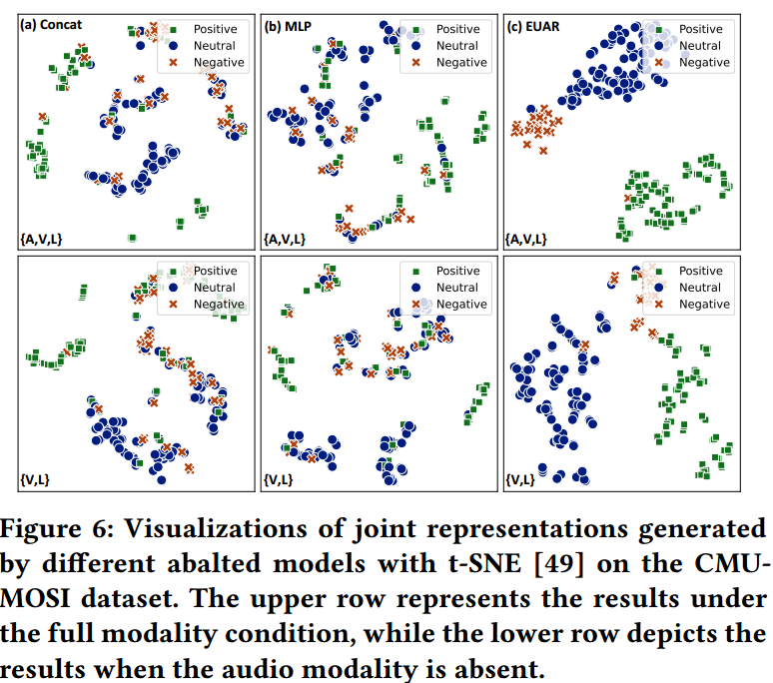
ATAI
AdvancedTechniqueof
Artificial Intelligence
ATAI
ChongqingUniversity _{AdvancedTechniqueof}
of Technology Artificial Intelligence
ChongqingUniversity of Technology
Experiments

Slide 13
ChongqingUniversity of Technology
ATAI
AdvancedTechniqueof
Artificial Intelligence
ATAI
ChongqingUniversity _{AdvancedTechniqueof}
of Technology Artificial Intelligence
Thanks!

